Slide 1
Developer Network Predix Suite 2017 Planning Aparna Sainath

Slide 2
Product Summary
The Predix Developer Network site provides software development tools, APIs, and technical resources designed specifically for IIoT app builders.

Slide 3
Release Goals
Create a Single Predix.io presence with multiple regions, so users can manage their apps in different regions under one user account.
Introduce Predix Studio and provide details on its offerings and how a user can subscribe to a Studio instance.
Add ability to search the Catalog for products and services.
Eliminate hard-coded pricing tables and display pricing directly from Nurego so pricing is based on region and organization privileges.
Publish Predix in Action stories based on industry.
Create a Data library for users.
Add ability to comment on the Documentation
Filter Guides per user personas--Developers, Data Scientists and Controls Engineer
Note: Work with your PM on the release goals.

Slide 4
Exelon will deploy GE’s full suite of Predix software apps across its entire generation fleet to increase performance and reliability. David, a Software Dev manager at Exelon, emails his team to learn about Predix offerings, so they can start building their IIoT application.

Slide 5
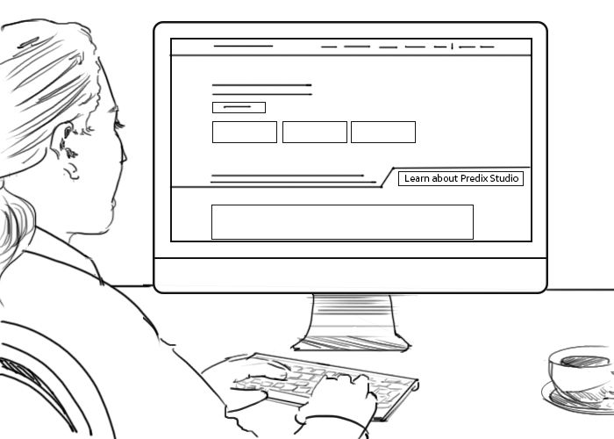
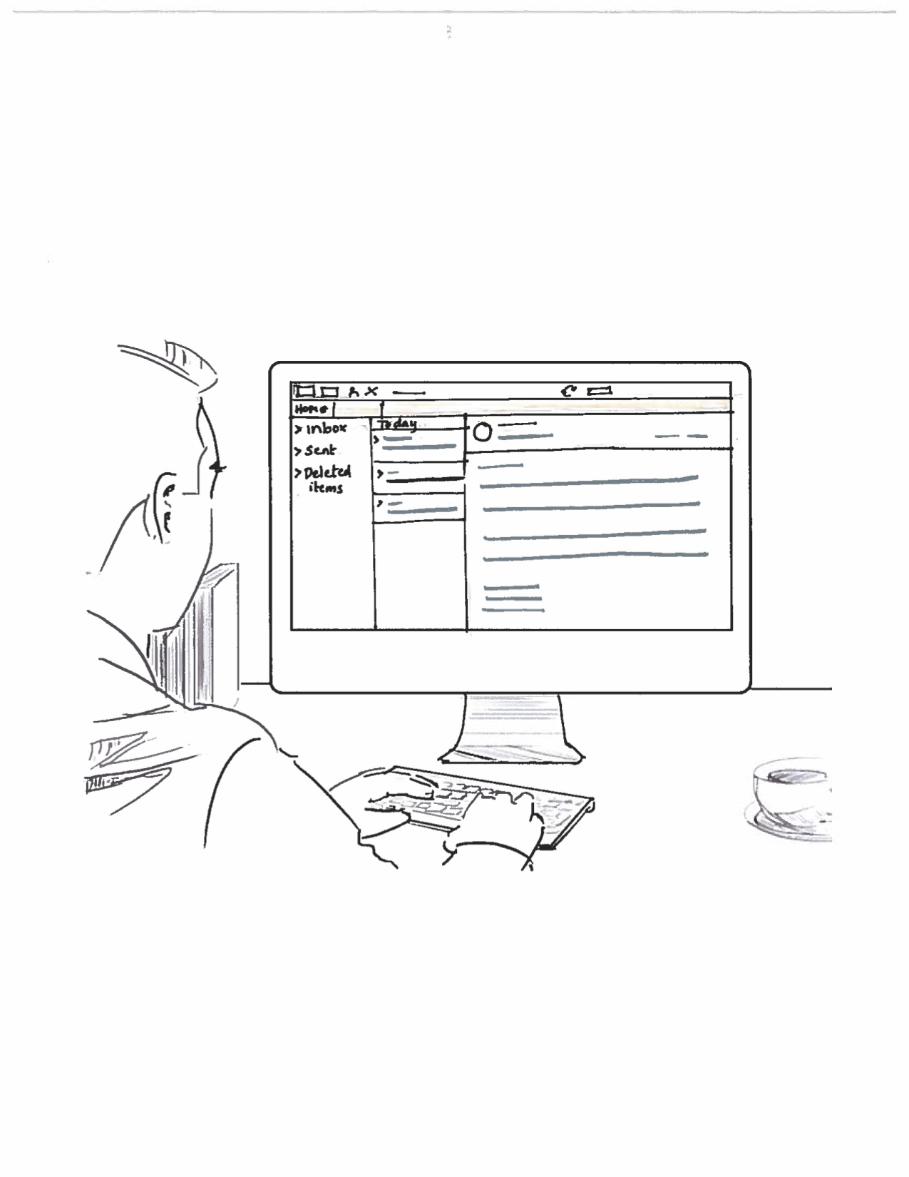
Developer Network
NARRATION
Olympia gets an email from her manager, David, asking her team to learn about Predix and start building their IIoT application.

Slide 6
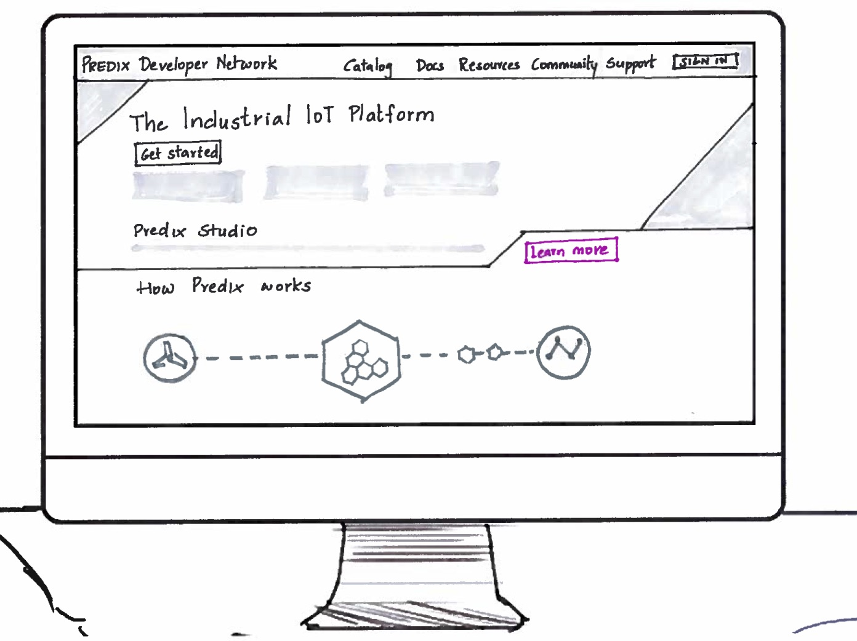
Developer Network
Full Screen Sketch
NARRATION
Olympia reviews Predix.io.
She is immediately drawn to Predix Studio – a low code application builder she has been seeking. Sandy shares the Predix site link with her local team and others in Banglore, India.
FEATURES
Single.io
Introduce Predix Studio on .io

Slide 7
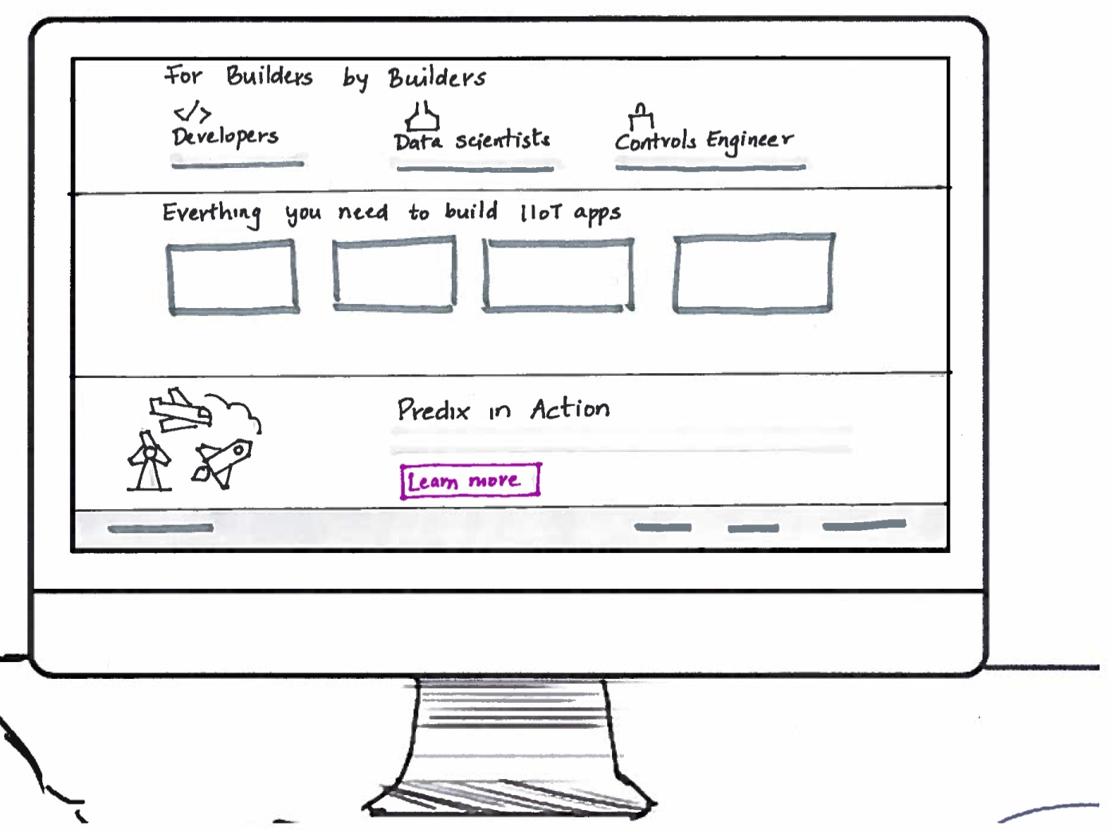
Developer Network
Full Screen Sketch
NARRATION
Olympia reviews Predix.io.
She is immediately drawn to Predix Studio – a low code application builder she has been seeking. Sandy shares the Predix site link with her local team and others in Banglore, India.
FEATURES
Single.io
Studio
Predix in action

Slide 8
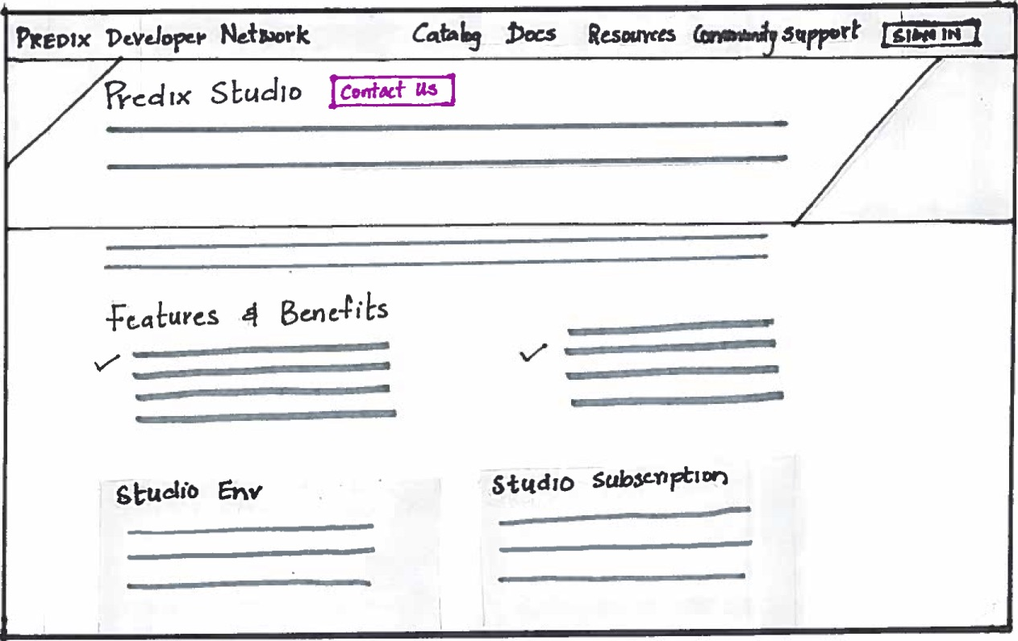
Developer Network
NARRATION
Olympia clicks Learn More to check out Predix Studio. She finds key information on Studio features and benefits, example use cases, subscription options, and more.
FEATURES
Introduce Predix Studio on .io

Slide 9
Developer Network
NARRATION
Meanwhile, Ahmed reads Olympia's email and clicks the Predix site link.

Slide 10
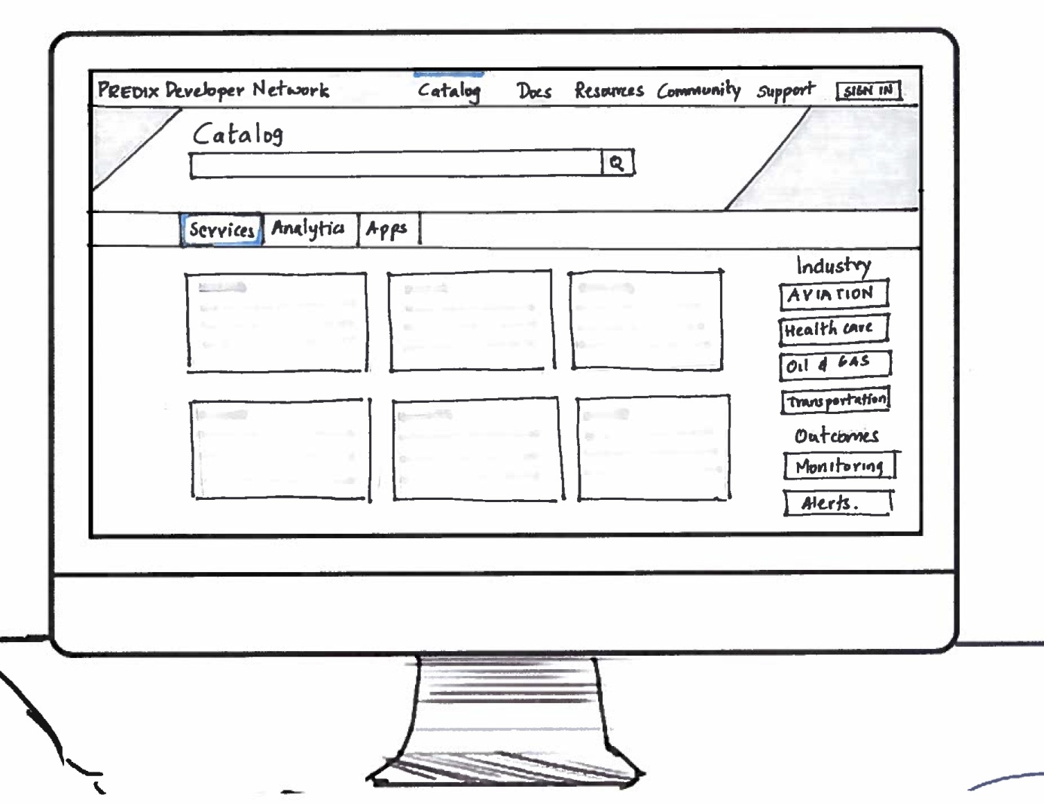
Developer Network
Full Screen Sketch
NARRATION
Ahmed reviews the Predix catalog products and services, and uses the search function to narrow his selection.
FEATURES
Catalog Search
Catalog filter
.

Slide 11
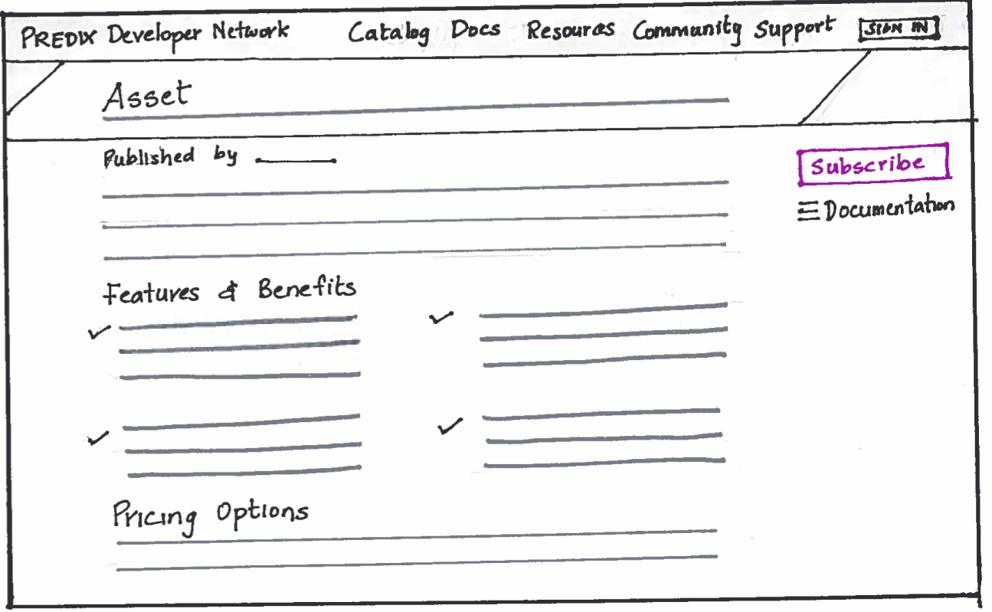
Developer Network
NARRATION
Ahmed is interested in the Asset service, so he goes to the description page to learn more. He is impressed with the detail and clarity of the service information.
FEATURES
Dynamic Pricing
Improved UI
Links to resources:
Tutorials
Case studies
Reference Architecture
Data Library

Slide 12
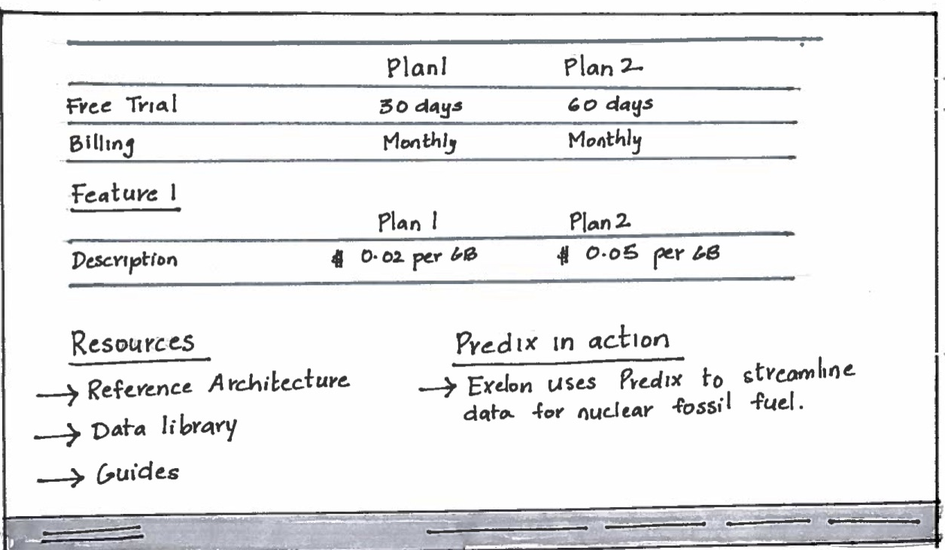
Developer Network
NARRATION
Ahmed is interested in the Asset service, so he goes to the description page to learn more. He is impressed with the detail and clarity of the service information.
FEATURES
Dynamic Pricing
Improved UI
Links to resources:
Tutorials
Case studies
Reference Architecture
Data Library

Slide 13
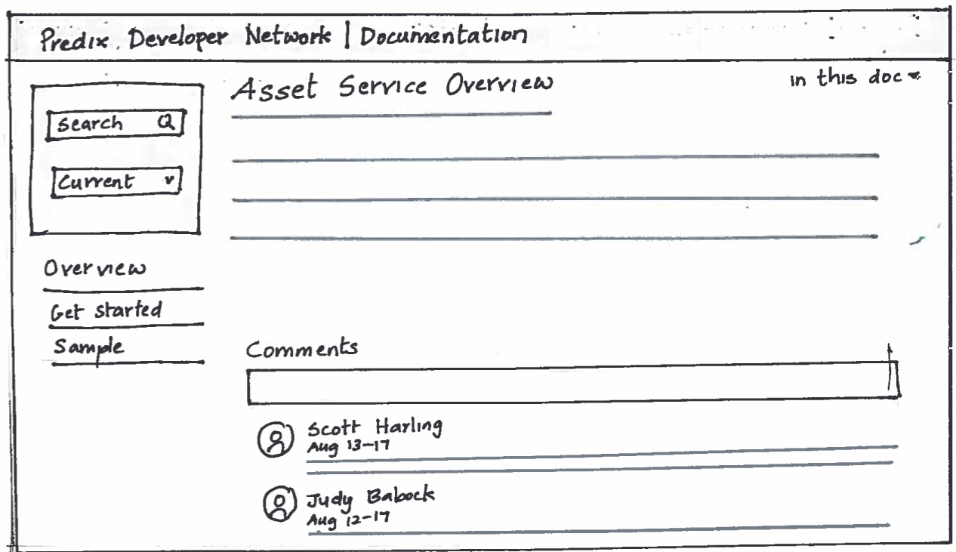
Developer Network
NARRATION
Ahmed then visits Predix Documentation, Guides and Predix in action to find out more about asset and how to integrate it.
FEATURES
Comments section on Documentation

Slide 14
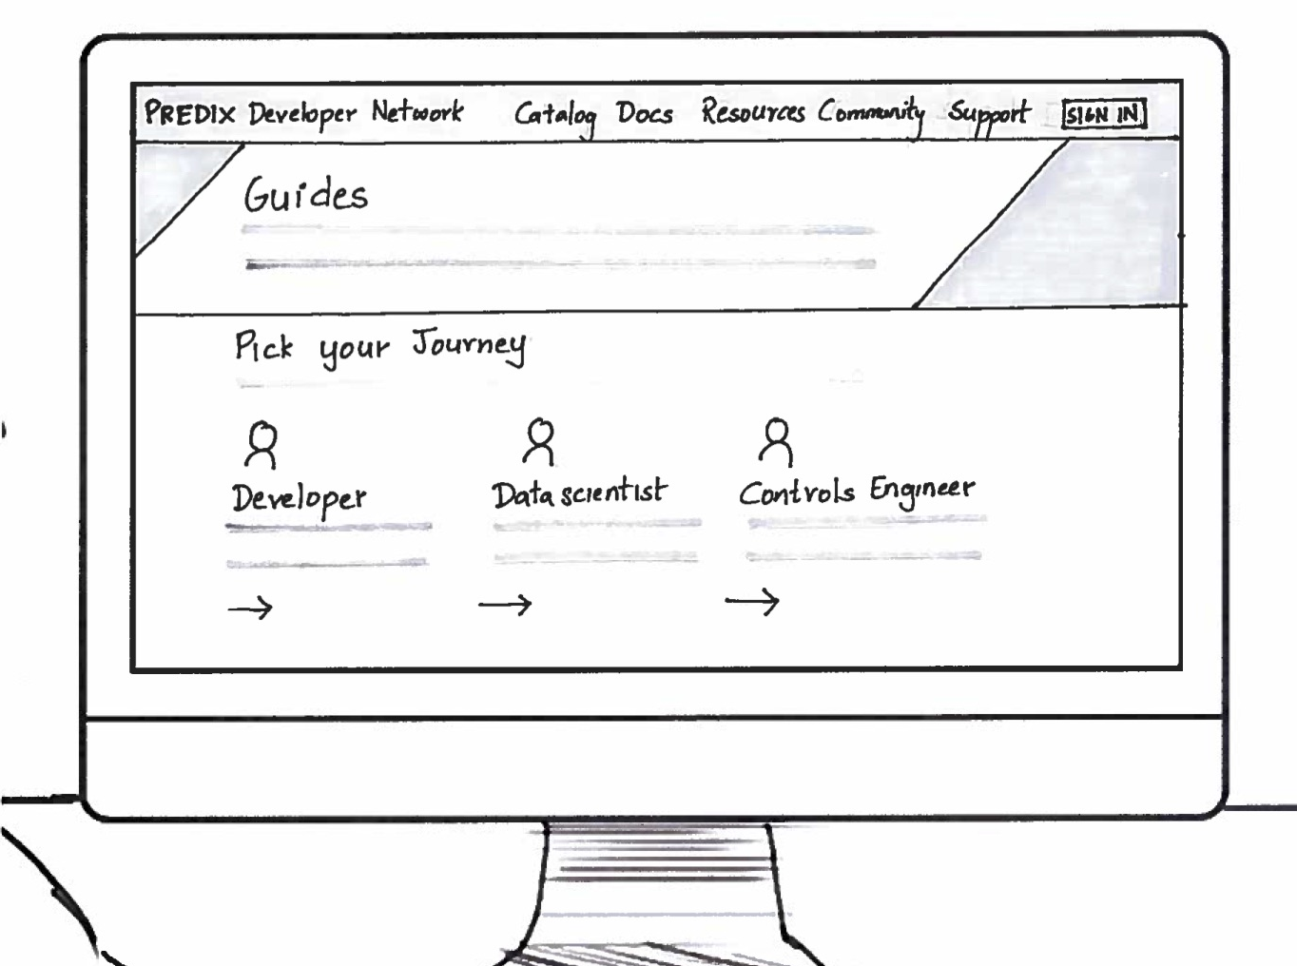
Developer Network
NARRATION
Ahmed then visits Predix Documentation, Guides and Predix in action to find out more about asset and how to integrate it.
FEATURES
Guides journey based on user persona

Slide 15
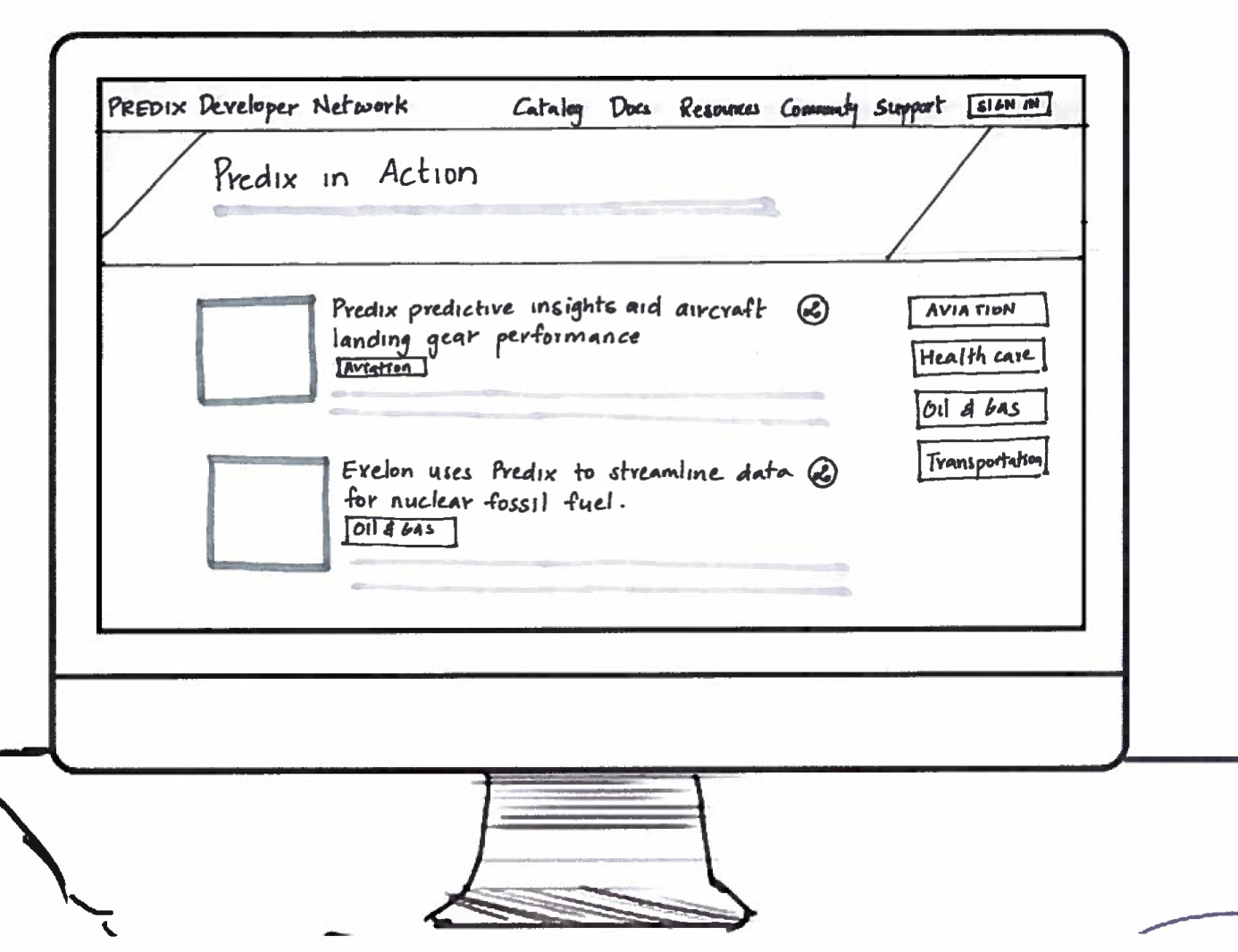
Developer Network
NARRATION
Ahmed then visits Predix Documentation, Guides and Predix in action to find out more about asset and how to integrate it.
FEATURES
PIA stories

Slide 16

Developer Network
NARRATION
Ahmed presents his findings about the Predix site, so others on the team can also register and start developing.

Slide 17
Assumptions & Dependencies
Federated UAA
Integrating Nurego for Dynamic pricing

